Slide 1
DSA LAB

Slide 2
Experiment List
Implementation of Infix to Postfix expression-Transformation and its evaluation program
Write a program that uses functions to perform the following operations on singly linked list i) Creation ii) Insertion iii) Deletion iv) Traversal.
Implementation of Stack and queue using doubly linked List
Implementation of Polynomial addition using linked list
Implementation of circular queue
Implementation of Fibonacci search and Binary search
Implementation of Insertion and selection sort
Implementation of BST (create,insert,traversal)
Implementation of BFS and DFS traversal
Implementation of hashing functions with Linear probing collision resolution techniques

Slide 3
Online compilers for C
Online C compiler-online editor
Online C compiler IDE-Jdoodle
Online C compiler –my Compiler

Slide 4
Implementation of Infix to Postfix expression-Transformation and its evaluation program
Algorithm
Let, X is an arithmetic expression written in infix notation. This algorithm finds the equivalent postfix expression Y.
Push “(“onto Stack, and add “)” to the end of X.
Scan X from left to right and repeat Step 3 to 6 for each element of X until the Stack is empty.
If an operand is encountered, add it to Y.
If a left parenthesis is encountered, push it onto Stack.
If an operator is encountered ,then:
Repeatedly pop from Stack and add to Y each operator (on the top of Stack) which has the same precedence as or higher precedence than operator.
Add operator to Stack. [End of If]
7. If a right parenthesis is encountered ,then:
Repeatedly pop from Stack and add to Y each operator (on the top of Stack) until a left parenthesis is encountered.
Remove the left Parenthesis. [End of If] [End of If]
8. END.

Slide 5
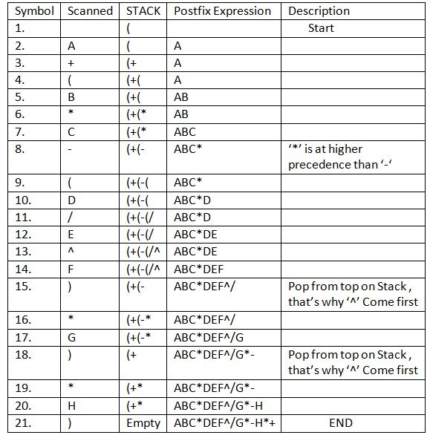
Example

Slide 6
Evaluation of Postfix expression
The algorithm for evaluation of postfix expression is as follows -
Create a stack that holds integer type data to store the operands of the given postfix expression. Let it be st.
Iterate over the string from left to right and do the following -
If the current element is an operand, push it into the stack.
Otherwise, if the current element is an operator (say /)do the following -
Pop an element from st, let it be op2.
Pop another element from st, let it be op1.
Computer the result of op1 / op2, and push it into the stack. Note the order i.e.i.e. op1 / op2 should not be changed otherwise it will affect the final result in some cases.
At last, st will consist of a single element i.e. the result after evaluating the postfix expression.

Slide 7
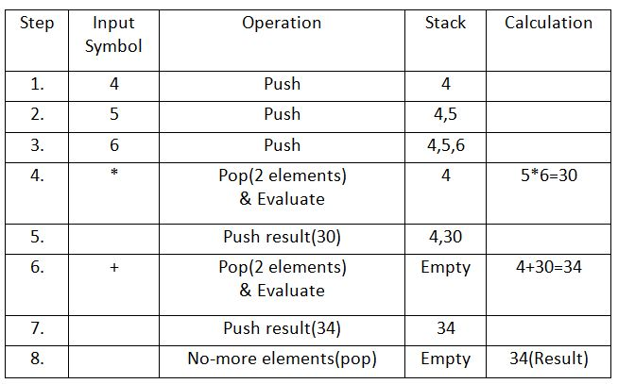
Example

Slide 8
Singly Linked List
There are various linked list operations that allow us to perform different actions on linked lists. For example, the insertion operation adds a new element to the linked list.
Here's a list of basic linked list operations that we will cover in this article.
Traversal - access each element of the linked list
Insertion - adds a new element to the linked list
Deletion - removes the existing elements
Search - find a node in the linked list
Sort - sort the nodes of the linked list

Slide 9
Things to Remember about Linked List
head points to the first node of the linked list
next pointer of the last node is NULL, so if the next current node is NULL, we have reached the end of the linked list.
In all of the examples, we will assume that the linked list has three nodes 1 --->2 --->3 with node structure as below:
struct node
{
int data;
struct node *next;
};

Slide 10
Traverse a Linked List
Displaying the contents of a linked list is very simple. We keep moving the temp node to the next one and display its contents.
When temp is NULL, we know that we have reached the end of the linked list so we get out of the while loop.
struct node *temp = head;
printf("\n\nList elements are - \n");
while(temp != NULL) {
printf("%d --->",temp->data);
temp = temp->next;
}
The output of this program will be:
List elements are -
1 --->2 --->3 --->

Slide 11
Insert Elements to a Linked List
You can add elements to either the beginning, middle or end of the linked list.
1. Insert at the beginning
Allocate memory for new node
Store data
Change next of new node to point to head
Change head to point to recently created node
struct node *newNode;
newNode = malloc(sizeof(struct node));
newNode->data = 4;
newNode->next = head;
head = newNode;

Slide 12
Insert Elements to a Linked List
2. Insert at the End
Allocate memory for new node
Store data
Traverse to last node
Change next of last node to recently created node
struct node *newNode;
newNode = malloc(sizeof(struct node));
newNode->data = 4;
newNode->next = NULL;
struct node *temp = head;
while(temp->next != NULL){
temp = temp->next;
}
temp->next = newNode;

Slide 13
Insert Elements to a Linked List
3. Insert at the Middle
Allocate memory and store data for new node
Traverse to node just before the required position of new node
Change next pointers to include new node in between
struct node *newNode;
newNode = malloc(sizeof(struct node));
newNode->data = 4;
struct node *temp = head;
for(int i=2; i < position; i++) {
if(temp->next != NULL) {
temp = temp->next;
}
}
newNode->next = temp->next;
temp->next = newNode;

Slide 14
Delete elements from linked list
You can delete either from the beginning, end or from a particular position.
1. Delete from beginning
Point head to the second node
head = head->next;
2. Delete from end
Traverse to second last element
Change its next pointer to null
struct node* temp = head;
while(temp->next->next!=NULL){
temp = temp->next;
}
temp->next = NULL;

Slide 15
Delete elements from linked list
3. Delete from middle
Traverse to element before the element to be deleted
Change next pointers to exclude the node from the chain
for(int i=2; i< position; i++) {
if(temp->next!=NULL) {
temp = temp->next;
}
}
temp->next = temp->next->next;

Slide 16
Search elements on linked list
You can search an element on a linked list using a loop using the following steps. We are finding item on a linked list.
Make head as the current node.
Run a loop until the current node is NULL because the last element points to NULL.
In each iteration, check if the key of the node is equal to item. If it the key matches the item, return true otherwise return false.
// Search a node
bool searchNode(struct Node** head_ref, int key) {
struct Node* current = *head_ref;
while (current != NULL) {
if (current->data == key) return true;
current = current->next;
}
return false;
}

Slide 17
Sort elements of a Linked List
We will use a simple sorting algorithm, Bubble Sort, to sort the elements of a linked list in ascending order below.
Make the head as the current node and create another node index for later use.
If head is null, return.
Else, run a loop till the last node (i.e. NULL).
In each iteration, follow the following step 5-6.
Store the next node of current in index.
Check if the data of the current node is greater than the next node. If it is greater, swap current and index.

Slide 18
Sort elements of a Linked List
void sortLinkedList(struct Node** head_ref)
{
struct Node *current = *head_ref, *index = NULL;
int temp;
if (head_ref == NULL) {
return;
} else {
while (current != NULL) {
// index points to the node next to current
index = current->next;
while (index != NULL) {
if (current->data > index->data) {
temp = current->data;
current->data = index->data;
index->data = temp;
}
index = index->next;
}
current = current->next;
}
}
}

Slide 19
Stack using doubly linked list
Functions to be Implemented:
Some of the basic functionalities on a stack covered here are:
push()
pop()
isEmpty()
printstack()
stacksize()
topelement()

Slide 20
Stack using doubly linked list
Push()
If the stack is empty then take a new node, add data to it and assign “null” to its previous and next pointer as it is the first node of the DLL. Assign top and start as the new node. Otherwise, take a new node, add data to it and assign the “previous” pointer of the new node to the “top” node earlier and next as “null”. Further, update the “top” pointer to hold the value of the new node as that will be the top element of the stack now.
void push(int d)
{
struct Node* n;
n = new Node();
n->data = d;
if (isEmpty()) {
n->prev = NULL;
n->next = NULL;
As it is first node
// if stack is empty
start = n;
top = n;
}
else {
top->next = n;
n->next = NULL;
n->prev = top;
top = n;
}
}

Slide 21
Stack using doubly linked list
Pop()
If the stack is empty, then print that stack is empty, Otherwise, assign top ->prev -> next as “null” and assign top as top->prev.
void pop()
{
struct Node* n;
n = top;
if (isEmpty())
printf("Stack is empty");
else if (top == start) {
top = NULL;
start = NULL;
free(n);
}
else {
top->prev->next = NULL;
top = n->prev;
free(n);
}
}

Slide 22
Stack using doubly linked list
PritnStack()
If the stack is empty, then print that stack is empty. Otherwise, traverse the doubly linked list from start to end and print the data of each node.
oid printstack()
{
if (isEmpty())
printf("Stack is empty");
else {
struct Node* ptr = start;
printf("Stack is : ");
while (ptr != NULL) {
printf("%d ", ptr->data);
ptr = ptr->next;
}
printf("\n");
}

Slide 23
Stack using doubly linked list
StackSize ()
If the stack is empty, then return zero else iterate from the start to end and count the number of nodes of the doubly linked list.
void stacksize()
{
int c = 0;
if (isEmpty())
printf("Stack is empty");
else {
struct Node* ptr = start;
while (ptr != NULL) {
c++;
ptr = ptr->next;
}
}
printf(" Size of the stack is : %d \n ", c);
}

Slide 24
Stack using doubly linked list
topElement
If the stack is empty, then there is no top element. Otherwise, print the element at the top node of the stack.
void topelement()
{
if (isEmpty())
printf("Stack is empty");
else
printf(
"The element at top of the stack is : %d \n",
top->data);
}

Slide 25
Stack using doubly linked list
topElement
If the stack is empty, then there is no top element. Otherwise, print the element at the top node of the stack.
void topelement()
{
if (isEmpty())
printf("Stack is empty");
else
printf(
"The element at top of the stack is : %d \n",
top->data);
}

Slide 26
Queue using doubly linked list
Functions to be Implemented:
Some of the basic functionalities on a stack covered here are:
enqueue()
dequeue()
isSize()
peek()
isEmpty()
printQdata()

Slide 27
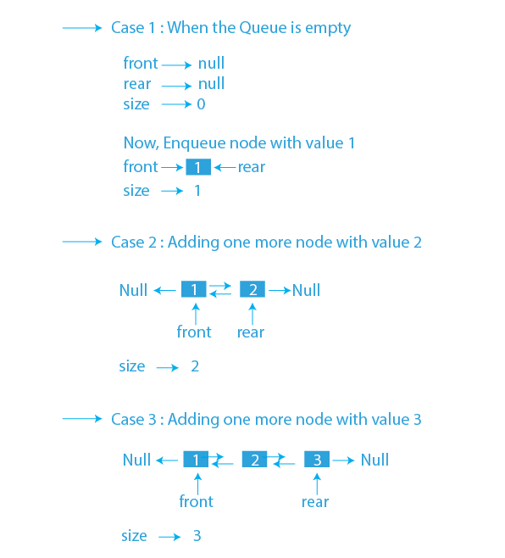
Queue using doubly linked list
Enqueue: This function is used to add an element in the queue in the rear end. There is a ref pointer of the doubly linked list which has a rear, front, and size pointer. In the case of enqueueing, we will add data in the new node and will pass it to the next pointer of the rear node. Also, we will increment the size pointer by 1 in case of insertion.

Slide 28
Queue using doubly linked list
Insertion at front end
Allocate space for a newNode of doubly linked list.
IF newNode == NULL, then
print "Overflow"
ELSE
IF front == NULL, then
rear = front = newNode
ELSE
newNode->next = front
front->prev = newNode
front = newNode
Insertion at rear end
Allocate space for a newNode of doubly linked list.
2. IF newNode == NULL, then
3. print "Overflow"
4. ELSE
5. IF rear == NULL, then
6. front = rear = newNode
7. ELSE
8. newNode->prev = rear
9. rear->next = newNode
10. rear = newNode

Slide 29
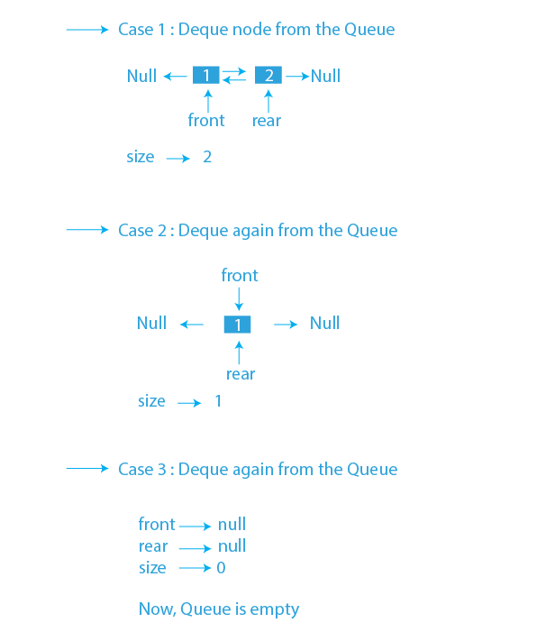
Queue using doubly linked list
Dequeue: This function is used to delete an element from the queue from the front end. From the ref, the front pointer will move to the front->next and will decrease the size pointer by 1. Also, return the data which is stored in the deleted node.
IF front == NULL
print "Underflow"
. ELSE
Initialize temp = front
front = front->next
IF front == NULL
rear = NULL
ELSE
front->prev = NULL
Deallocate space for temp

Slide 30
Queue using doubly linked list
Deletion from front end : .
IF front == NULL
2. print "Underflow"
3. ELSE
4. Initialize temp = front
5. front = front->next
6. IF front == NULL
7. rear = NULL
8. ELSE
9. front->prev = NULL
10 Deallocate space for temp
Deletion from Rear end :
IF front == NULL
2. print "Underflow"
3. ELSE
4. Initialize temp = rear
5. rear = rear->prev
6. IF rear == NULL
7. front = NULL
8. ELSE
9. rear->next = NULL
10 Deallocate space for temp

Slide 31

Polynomial Addition using Linked List
We store each polynomial as a linked list where each node stores exponent and coefficient in the data part and reference to the next node . their sum is then stored in another linked list.

Slide 32
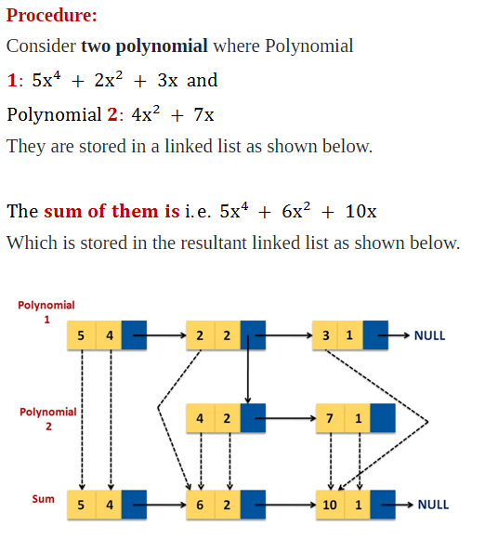
Polynomial Addition using Linked List

Slide 33
Polynomial Addition using Linked List
Create a new linked list, newHead to store the resultant list.
Traverse both lists until one of them is null.
If any list is null insert the remaining node of another list in the resultant list.
Otherwise compare the degree of both nodes, a (first list as node) and b (second list as node). Here three cases are possible:
If the degree of a and b is equal, we insert a new node in the resultant list with the coefficient equal to the sum of coefficients of a and b and the same degree.
If the degree of a is greater than b, we insert a new node in the resultant list with the coefficient and degree equal to that of a.
If the degree of b is greater than a, we insert a new node in the resultant list with the coefficient and degree equal to that of b.

Slide 34
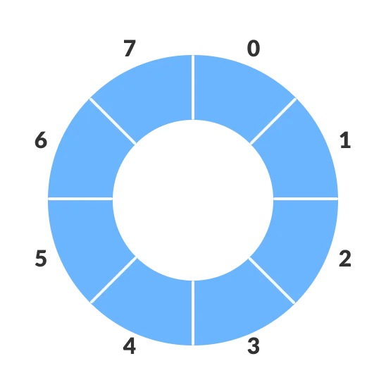
Circular queue
A circular queue is the extended version of a regular queue where the last element is connected to the first element. Thus forming a circle-like structure.
The circular queue solves the major limitation of the normal queue. In a normal queue, after a bit of insertion and deletion, there will be non-usable empty space.
Here, indexes 0 and 1 can only be used after resetting the queue (deletion of all elements). This reduces the actual size of the queue.

Slide 35
How Circular Queue Works
Circular Queue works by the process of circular increment i.e. when we try to increment the pointer and we reach the end of the queue, we start from the beginning of the queue.
Here, the circular increment is performed by modulo division with the queue size. That is,
if REAR + 1 == 5 (overflow!), REAR = (REAR + 1)%5 = 0 (start of queue)

Slide 36
Circular Queue Operations
The circular queue work as follows:
two pointers FRONT and REAR
FRONT track the first element of the queue
REAR track the last elements of the queue
initially, set value of FRONT and REAR to -1

Slide 37
Operations
Enqueue Operation
check if the queue is full
for the first element, set value of FRONT to 0
circularly increase the REAR index by 1 (i.e. if the rear reaches the end, next it would be at the start of the queue)
add the new element in the position pointed to by REAR
Dequeue Operation
check if the queue is empty
return the value pointed by FRONT
circularly increase the FRONT index by 1
for the last element, reset the values of FRONT and REAR to -1

Slide 38
Operations
However, the check for full queue has a new additional case:
Case 1: FRONT = 0 && REAR == SIZE - 1
Case 2: FRONT = REAR + 1
The second case happens when REAR starts from 0 due to circular increment and when its value is just 1 less than FRONT, the queue is full.
However, the check for full queue has a new additional case:
Case 1: FRONT = 0 && REAR == SIZE - 1
Case 2: FRONT = REAR + 1
The second case happens when REAR starts from 0 due to circular increment and when its value is just 1 less than FRONT, the queue is full.

Slide 39
Enqueue
Step 1: IF (REAR+1)%MAX = FRONT
Write " OVERFLOW "
Goto step 4
[End OF IF]
Step 2: IF FRONT = -1 and REAR = -1
SET FRONT = REAR = 0
ELSE IF REAR = MAX - 1 and FRONT ! = 0
SET REAR = 0
ELSE
SET REAR = (REAR + 1) % MAX
[END OF IF]
Step 3: SET QUEUE[REAR] = VAL
step 4 exit

Slide 40
Dequeue
Step 1: IF FRONT = -1
Write " UNDERFLOW "
Goto Step 4
[END of IF]
Step 2: SET VAL = QUEUE[FRONT]
Step 3: IF FRONT = REAR
SET FRONT = REAR = -1
ELSE
IF FRONT = MAX -1
SET FRONT = 0
ELSE
SET FRONT = FRONT + 1
[END of IF]
[END OF IF]
Step 4: EXIT

Slide 41
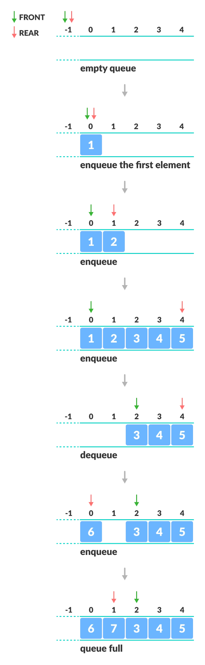
Example

Slide 42
Binary search
Binary Search is one of the fastest searching algorithms.
It is used for finding the location of an element in a linear array.
It works on the principle of divide and conquer technique.
Binary Search Algorithm can be applied only on Sorted arrays.
So, the elements must be arranged in-
Either ascending order if the elements are numbers.
Or dictionary order if the elements are strings.
To apply binary search on an unsorted array,
First, sort the array using some sorting technique.
Then, use binary search algorithm.

Slide 43
Binary search
1. In Binary Search technique, we search an element in a sorted array by recursively dividing the interval in half.
2. Firstly, we take the whole array as an interval.
3. If the element being searched is found to be the middle most element, its index is returned.
3. If the element being searched is found to be smaller than the middle most element, then its search is further continued in the left sub array of the middle most element.
4. f the element being searched is found to be greater than the middle most element, then its search is further continued in the right sub array of the middle most element.
5. This iteration keeps on repeating on the sub arrays until the desired element is found or size of the sub array reduces to zero.

Slide 44
Algorithm
int binarySearch(int arr[], int l, int r, int x)
{
if (r >= l) {
int mid = l + (r - l) / 2;
// If the element is present at the middle
if (arr[mid] == x)
return mid;
// If element is smaller than mid, then
// it can only be present in left subarray
if (arr[mid] > x)
return binarySearch(arr, l, mid - 1, x);
// Else the element can only be present
// in right subarray
return binarySearch(arr, mid + 1, r, x);
}
// We reach here when element is not
// present in array
return -1;
}

Slide 45
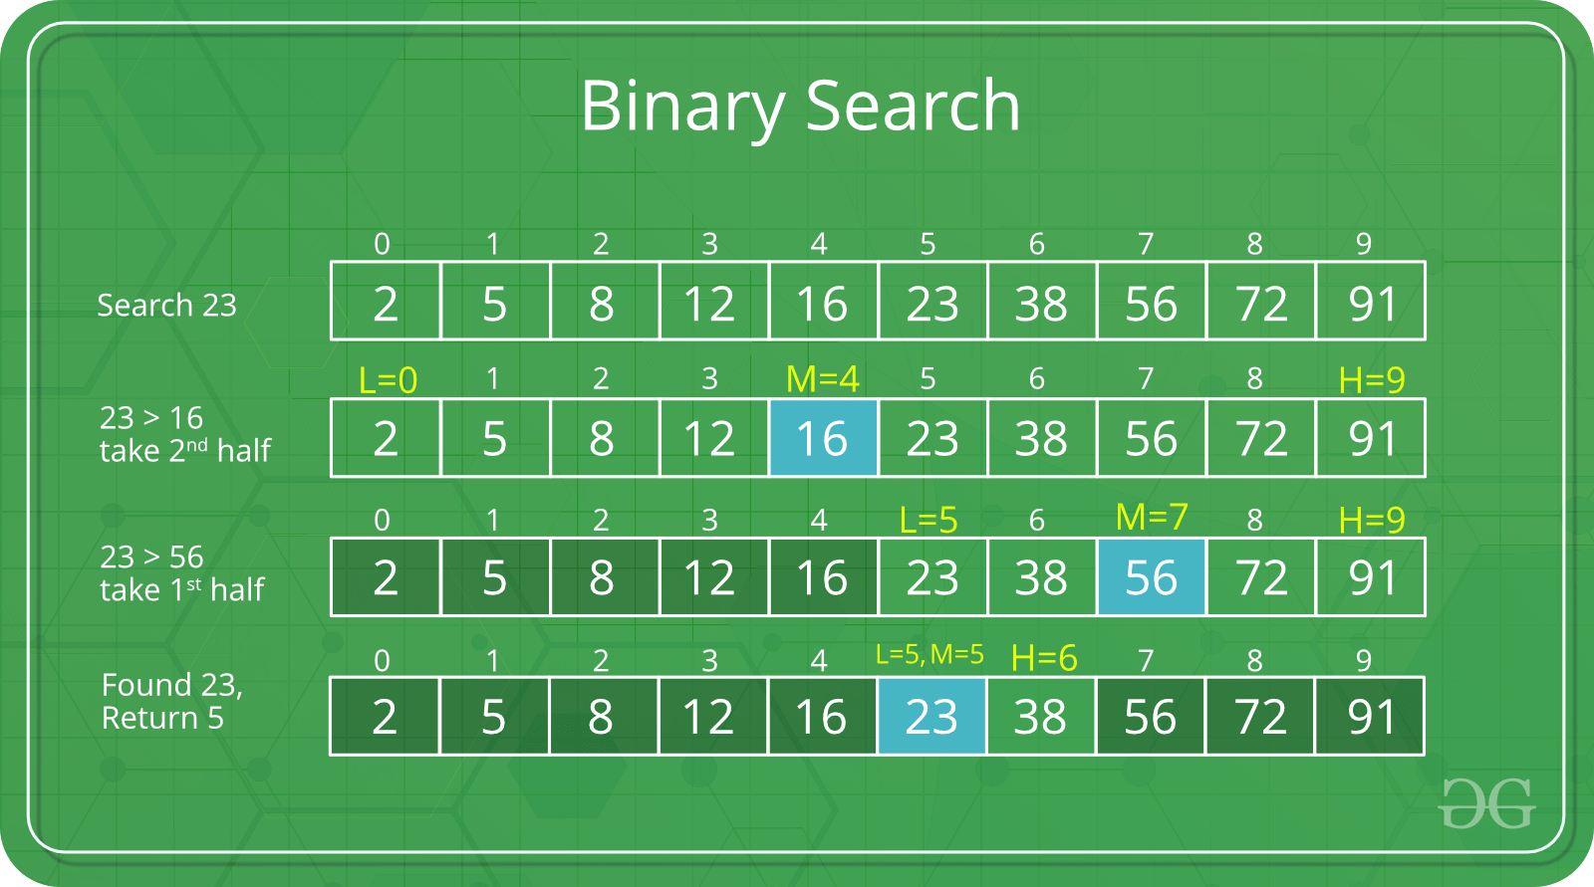
Example
Consider-
We are given the following sorted linear array.
Element 15 has to be searched in it using Binary Search Algorithm.

Slide 46
Fibonacci search
Fibonacci search is an efficient search algorithm based on divide and conquer principle that can find an element in the given sorted array with the help of Fibonacci series in O(log N) time complexity. This is based on Fibonacci series which is an infinite sequence of numbers denoting a pattern which is captured by the following equation:
F(n+1)=F(n)+F(n-1)
where F(i) is the ith number of the Fibonacci series where F(0) and F(1) are defined as 0 and 1 respectively.
The first few Fibonacci numbers are:
0,1,1,2,3,5,8,13....

Slide 47
Fibonacci search
F(0) = 0
F(1) = 1
F(2) = F(1) + F(0) = 1 + 0 = 1
F(3) = F(2) + F(1) = 1 + 1 = 2
F(4) = F(3) + F(2) = 1 + 2 = 3 and so continues the series
Other searches like binary search also work for the similar principle on splitting the search space to a smaller space but what makes Fibonacci search different is that it divides the array in unequal parts and operations involved in this search are addition and subtraction only which means light arithmetic operations takes place and hence reducing the work load of the computing machine.

Slide 48
Algorithm
Let the searched element be x.
The idea is to first find the smallest Fibonacci number (F(k)) that is greater than or equal to the length of the given array n
Let the two Fibonacci numbers preceding it be F(k1) [(k-1)’th Fibonacci Number] and F(k2) [(k-2)’th Fibonacci Number.
if F(k)=0 then stop and print the message as element not found.
set offset=-1
i= min(offset +F(k-2),n-1)
if x==a[i]
return i and search successful
if s>a[i]
k=k-1, offset=i and repeat step 4,5
if s<a[i]
k=k-2 repeat steps 4,5

Slide 49
Example
2 | 3 | 7 | 13 | 21 | 28 | 31
element to be searched x=21
Step 1:
k= 0 1 2 3 4 5 6 7 8
Fib 0 1 1 2 3 5 8 13 21
F(k)=length of array-1=n+1=7+1=8
F(k-1)=5 F(k-2)=3
offset=-1
i=min(-1+3,7)=2
21>a[2]=21>7
k=k-1=the fibonacci number in the sequence before 8=5
Step 2
f(k)=5 offset=i=2
f(k-1)=3,f(k-2)=2
i=min(2+2,7)=4
21=a[4]=21
element found at position 4

Slide 50
Complexity
Worst case time complexity: Θ(logn)
Average case time complexity: Θ(log n)
Best case time complexity: Θ(1)
Space complexity: Θ(1)

Slide 51
Applications
Key points about Fibonacci search are:
Fibonacci Search examines closer elements in few steps. So when input array is big that cannot fit in CPU cache or in RAM, it is useful.
On average, fibonacci search requires 4% more comparisons than binary search
Fibonacci search requires only addition and subtraction whereas binary search requires bit-shift, division or multiplication operations.
Fibonacci search can reduce the time needed to access an element in a random access memory.
On magnetic tape where seek time depends on the current head position, there are two considerations: longer seek time and more comparisons that leads to prefer Fibonacci search

Slide 52
Insertion sort
Step 1 - If the element is the first element, assume that it is already sorted. Return 1.
Step2 - Pick the next element, and store it separately in a key.
Step3 - Now, compare the key with all elements in the sorted array.
Step 4 - If the element in the sorted array is smaller than the current element, then move to the next element. Else, shift greater elements in the array towards the right.
Step 5 - Insert the value.
Step 6 - Repeat until the array is sorted.

Slide 53
Selection Sort
SELECTION SORT(arr, n)
Step 1: Repeat Steps 2 and 3 for i = 0 to n-1
Step 2: CALL SMALLEST(arr, i, n, pos)
Step 3: SWAP arr[i] with arr[pos]
[END OF LOOP]
Step 4: EXIT
SMALLEST (arr, i, n, pos)
Step 1: [INITIALIZE] SET SMALL = arr[i]
Step 2: [INITIALIZE] SET pos = i
Step 3: Repeat for j = i+1 to n
if (SMALL > arr[j])
SET SMALL = arr[j]
SET pos = j
[END OF if]
[END OF LOOP]
Step 4: RETURN pos

Slide 54
BST-Insertion
Step 1: IF TREE = NULL
Allocate memory for TREE
SET TREE -> DATA = ITEM
SET TREE -> LEFT = TREE -> RIGHT = NULL
ELSE
IF ITEM < TREE -> DATA
Insert(TREE -> LEFT, ITEM)
ELSE
Insert(TREE -> RIGHT, ITEM)
[END OF IF]
[END OF IF]
Step 2: END

Slide 55
Traversal
void inorder(struct node *p)
{
if(p!=NULL)
{
inorder(p->left);
printf("\nData :%d",p->data);
inorder(p->right);
}
else
return;
}

Slide 56
Traversal
void preorder(struct node *p)
{
if(p!=NULL)
{
printf("\nData :%d",p->data);
preorder(p->left);
preorder(p->right);
}
else
return;
}
void postorder(struct node *p)
{
if(p!=NULL)
{
postorder(p->left);
postorder(p->right);
printf("\nData :%d",p->data);
}
else
return;
}

Slide 57
BFS
Step 1 : SET STATUS=1 (ready state) for each node in G. Step 2 : Enqueue the starting node A and set its STATUS = 2 (waiting state) Step 3 : Repeat Step 4 and 5 until QUEUE is empty Step 4 : Dequeue a node N. Process it and set its STATUS =3 (processed state) Step 5 : Enqueue all the neighbors of N that are in the ready state (whose STATUS = 1) and set their STATUS = 2 (waiting state)
[END OF LOOP]
Step 6: EXIT

Slide 58
DFS
First, create a stack with the total number of vertices in the graph.
Now, choose any vertex as the starting point of traversal, and push that vertex into the stack.
After that, push a non-visited vertex (adjacent to the vertex on the top of the stack) to the top of the stack.
Now, repeat steps 3 and 4 until no vertices are left to visit from the vertex on the stack's top.
If no vertex is left, go back and pop a vertex from the stack.
Repeat steps 2, 3, and 4 until the stack is empty.

Slide 59
Hashing-Linear probing
Algorithm to insert a value in linear probing
Hashtable is an array of size = TABLE_SIZE
Step 1: Read the value to be inserted, key
Step 2: let i = 0
Step 3: hkey = key% TABLE_SIZE
Step 4 :compute the index at which the key has to be inserted in hash table
index = (hkey + i) % TABLE_SIZE
Step 5: if there is no element at that index then insert the value at index and STOP
Step 6: If there is already an element at that index
step 4.1: i = i+1
step 7: if i < TABLE_SIZE then go to step 4

Slide 60
Hashing-Linear probing
Algorithm to search a value in linear probing
Hashtable is an array of size = TABLE_SIZE
Step 1: Read the value to be searched, key
Step 2: let i = 0
Step 3: hkey = key% TABLE_SIZE
Step 4: compute the index at which the key can be found
index = (hkey+ i) % TABLE_SIZE
Step 5: if the element at that index is same as the search value then print element found and STOP
Step 6: else
step 4.1: i = i+1
step 7: if i < TABLE_SIZE then go to step 4

